Slide 1
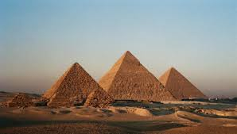
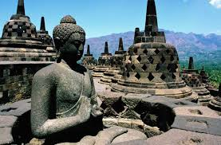
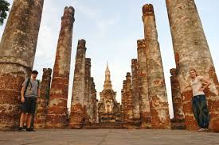

Slide 2
Historical site is?
a. Official location where pieces of history have been preserved due to their cultural heritage value.
b. Official location where pieces of history have been placed due to their oldest

Slide 3
Historical site in Egypt?
a. Eiffel tower
b. Pyramid

Slide 4
Historical site in Indonesia?
a. Pyramid
b. Borobudur

Slide 5
Historical site in Thailand?
a. Sukhothai park
b. Sphinx

Slide 6
Sturucture of recount text?
a. Orientation, events, re-orientation
b. Events, orientation, re-orientation

Slide 7
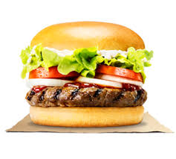
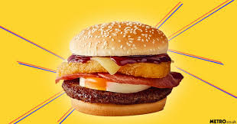
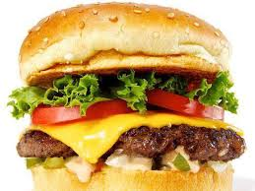
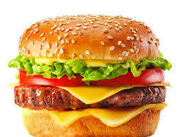
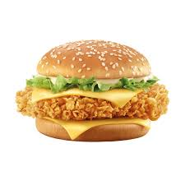

Slide 8
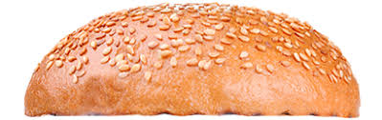
Top Bun = ORIENTATION
Yesterday my family went to the zoo to see the
elephant and other animal.
Who?
Where? บทนำ
When?

Slide 9
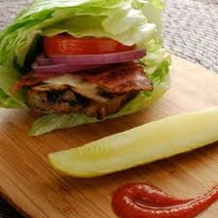
Lettuce, Meat, Cheese = EVENT
Yesterday my family went to the zoo to see the
elephant and other animal. When we got to the zoo, we went to the shop to buy some food to
give to the animals.
After getting the food we went to the nocturnal house where we saw birds and reptiles which
only come out at night.
SEQUENCE/ ลำดับเหตุการณ์

Slide 10
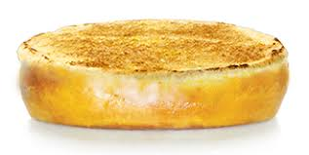
Bottom Bun = RE-ORIENTATION
we were tired but
happy because we had so much fun.
Optional closing/ไม่จำเป็น
(impression)

